Slide 1
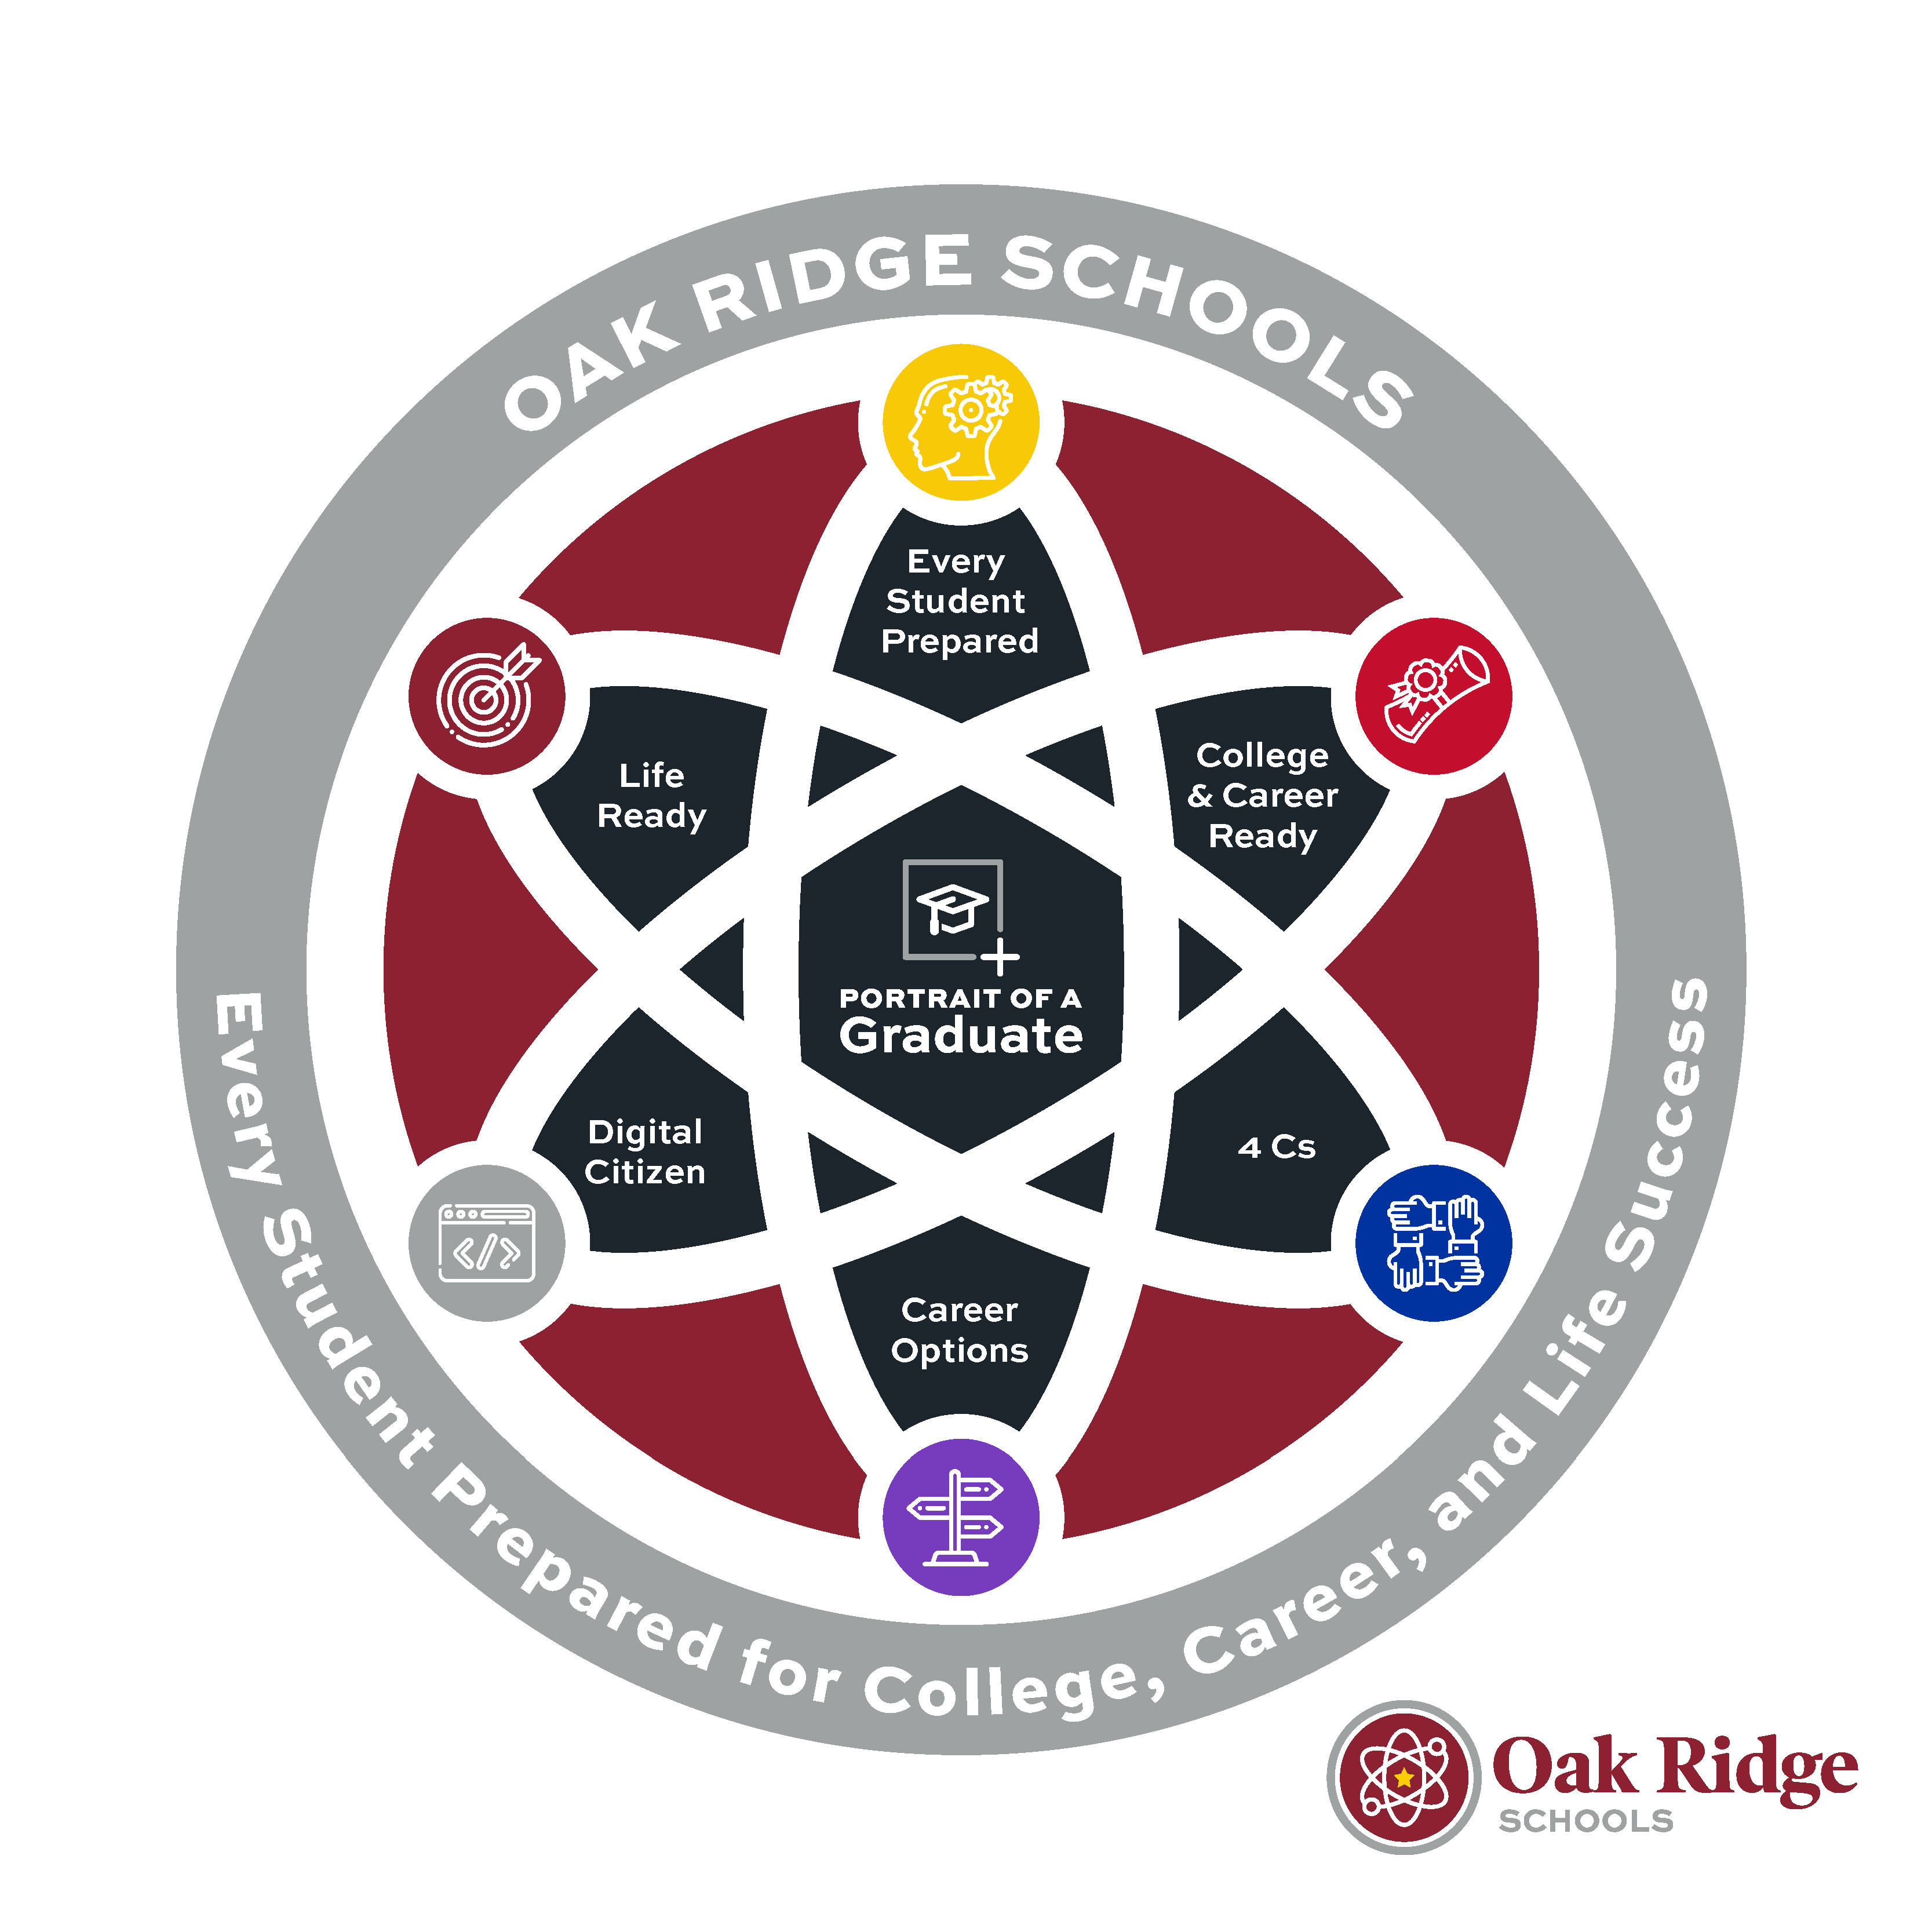
Today we are sharing the final portrait of a graduate for the Oak Ridge Schools. We ask that you share it with your staff by Nov. 20 and with your students & families by Dec. 18.
We have many resources for you:
Slide deck
Final Portrait document
Handout
Videos

Slide 2
Our Portrait
of an
Oak Ridge Schools’
Graduate

Slide 3
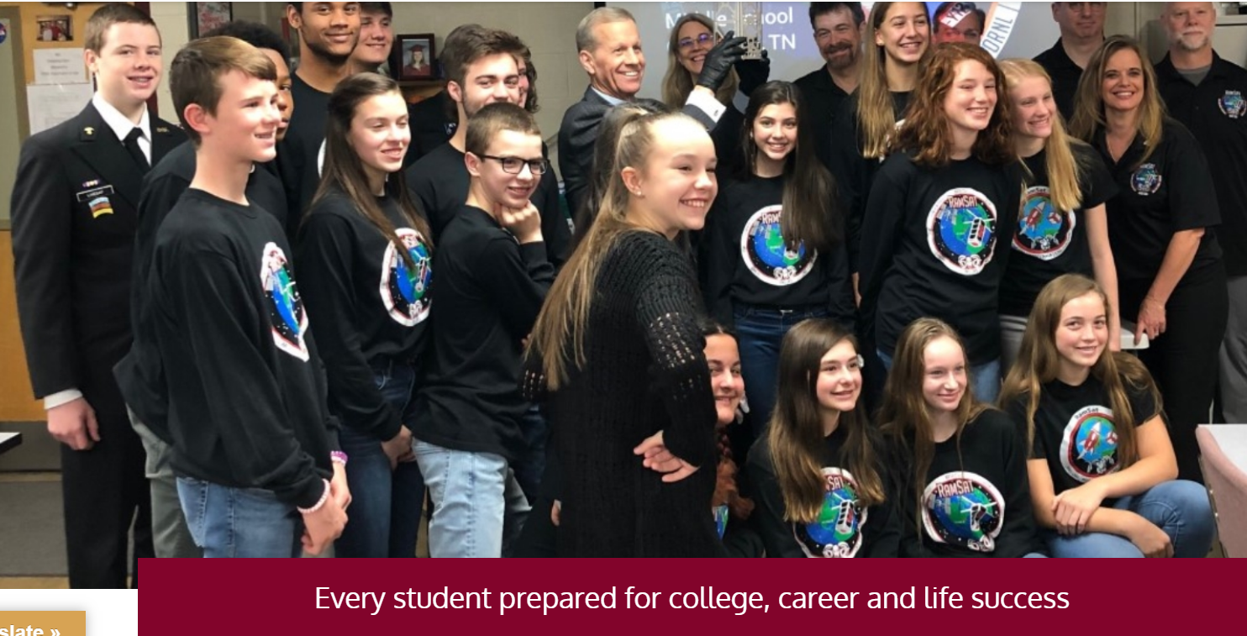
Why CREATE a portrait of a graduate?
Notes:
This is our vision and the Portrait of a Graduate will help us realize this vision.

Slide 4

Thank you for helping develop our portrait
To you and the many teachers who developed the profile for each school level
To the 1100+ employees and families that offered input via a survey
Notes:
Express gratitude to your team

Slide 5

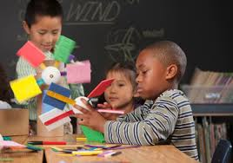

what is a portrait of a graduate?
      A shared understanding of what
      key skills and competencies students exhibit that predict success in college, career and life
      following graduation from Oak Ridge Schools

Slide 6
Our oak ridge Portrait of a graduate
Dr. Borchers Video
Notes:
Use link to Dr. Borchers video

Slide 7
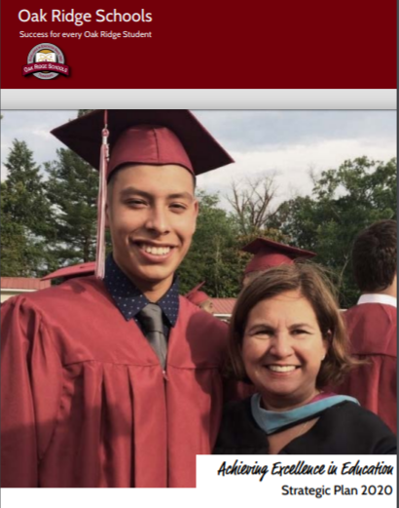
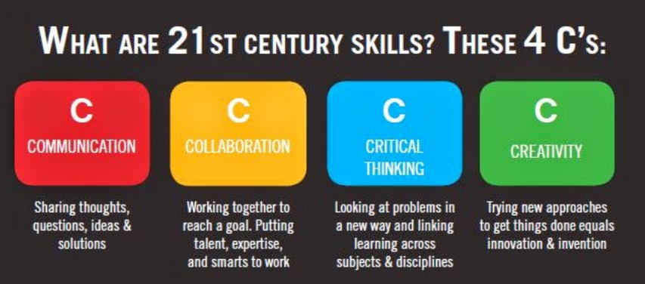
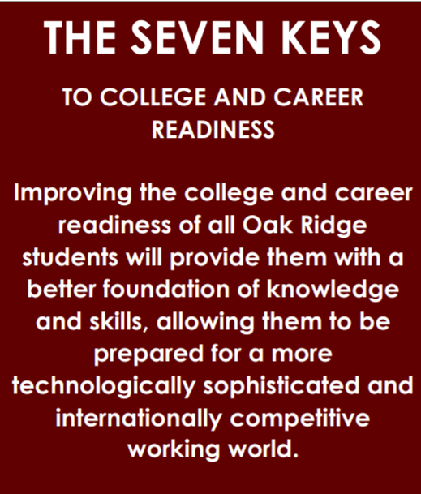



How Our portrait of an oak ridge schools’ graduate links our work
Oak
Ridge
Schools
Portrait of a Graduate

Slide 8
Why CREATE a portrait of a graduate?
    To achieve college- and career-readiness for every student by developing a shared vision among all key stakeholders regarding the key competencies that students need to be successful in work, citizenship, and life.
    Identify the key competencies students will exhibit as they move on from Pre-K, elementary, middle and high school that predict success in work, citizenship and life upon high school graduation.
    Connect the dots and communicate clearly what we hold as hopes, dreams and aspirations for our Oak Ridge students. Bring unity and clarity to our Oak Ridge 2020, our 7 Keys, and key indicators from our scorecards.

Slide 9
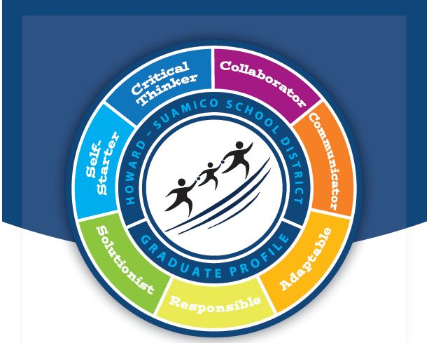

Typical portraits of a graduate

Slide 10
Let’s reflect and discuss
    Find a partner to talk with. As you listen to your partner talk, capture some key words and phrases to share with the group:
    How will you describe the WHY of the Portrait of an Oak Ridge Schools’ Graduate when you talk about it?
    How does it “connect the dots” of the many facets of work we have going on in Oak Ridge? How can you leverage the way it brings key work together as you explain it?
Notes:
Get people in a small group of 2-3 to discuss these two questions

Slide 11
What makes our portrait unique
Comprehensiveness – more than “non-academic” attributes
K-12 Perspective – Progression by Level

Slide 12

How Our portrait of a graduate is organized
College- and Career-Ready Success Indicators
  Key Academic Indicators from the Oak Ridge 7 Keys
  Applying 4 C’s in STEM/Problem-Based Learning and all curricular areas: Critical Thinking, Communication, Collaboration & Creativity
  Understanding Career Options
  Using Technology Effectively
Life-Ready Success Indicators
  Key Indicators of social/emotional strength
    Self-Awareness, Self-Discipline & Empathy
Possessing Financial Fluency (demonstrated at high school)

Slide 13
Indicators of empathy in Pre-K
Pre-K students will display empathy as they:
      Recognize and label basic emotions in books and photographs and use words to describe own feelings.
      Express care and concern toward others.
      Understand that people have similarities and differences.

Slide 14
Indicators of empathy in elementary
Elementary students will display empathy as they:
  Accept people who are different.
  Respect different points of view and show kindness in resolving conflict.
  Be open and receptive to new ideas.
      Demonstrate global awareness and sensitivity (e.g. see how peoples’ similarities and differences affect not only self but others and the world).

Slide 15
Indicators of empathy in middle school
Middle school students will display empathy as they:
  Show compassion for others and a desire to help all people, realizing everyone has struggles of their own.
  Demonstrate an appreciation of others’ ideas and actions by means of listening, showing kindness, and helping others.
  Seek to understand and respect those who are different (e.g. culturally, socially, emotionally, and academically).
      Demonstrate global awareness and sensitivity (e.g. understand cultural similarities and differences and be respectful of these).

Slide 16
Indicators of empathy in high school
High school students will display empathy as they:
Participate in hands-on community service.
Accept and offer critiques with grace, value and honesty.
Demonstrate sensitivity (e.g. show tolerance and respect when others display/do not display tolerance or respect)
      Demonstrate tolerance and cultural understanding (e.g. be aware of personal world view and be able to effectively interact and work productively with people of varying cultures).

Slide 17
Our aspirations
    We want the Portrait to communicate this shared vision to our students and families, so we have greater clarity around our vision and priorities to achieve it.
    We will help our entire Oak Ridge Schools community to become familiar with these indicators by school level and support you in using this Portrait of an Oak Ridge Schools' Graduate in the classroom.
    In the future, we will report out how students are exhibiting these competencies.
Dr. Renegar Video Clip
Notes:
. Show the video clip after you relay the aspirations. Ask people to listen to identify one new area of new clarity about the Portrait of a Graduate.

Slide 18
Time to review the portrait for our school
    Take a few minutes to peruse the Portrait of an Oak Ridge Schools’ graduate. Look intently at the section for our students.
    Reflect on the following questions as you look it over:
      How might this be helpful for you?
      How might this be helpful for students?
      How might this be helpful for families?
      What questions do you have?
Notes:
. Give people a copy of the POG and let them look at it for a few minutes. Then ask someone to note take and ask for input on these four questions.

Slide 19
Let’s reflect and discuss
    As you listen to your partner talk, capture some key words and phrases to share with the group:
    How do you see the Portrait of an Oak Ridge Schools’ Graduate being used in the classroom? How can it guide our work and communicate our priorities for students and families?
    For our Portrait of an Oak Ridge Schools’ Graduate to be as impactful as we want it to be, what is key for us to do this year? What do you need for this to be impactful?

Slide 20
Why CREATE a portrait of a graduate?

Slide 21
Thank you for your input

